Slide 1
C++11 (aka C++0x) in Visual C++ 2010
August 1st, 2011
Marc Gregoire
marc.gregoire@nuonsoft.com
http://www.nuonsoft.com/
http://www.nuonsoft.com/blog/

Slide 2
What is Supported in VC++ 2010?
Right angle brackets
Real null pointer type (nullptr)
std::bind
Alternative function syntax (trailing return type)
Type deduction (auto, decltype)
Shared pointers (shared_ptr, unique_ptr)
Lambda expressions
Unordered associative containers / hash tables (unordered_map, unordered_multimap, unordered_set, unordered_multiset)
std::array
Rvalue references (Move semantics)
Compile time static assertions (static_assert)
Regular expression library <regex>
Random number generation library <random>
New STL Algorihtms

Slide 3
Right Angle Brackets
Pre-C++11: >> always means operator>>
This is a problem for nested templates
Space required between the brackets > >
C++11: No space required anymore ☺
Example:
vector<basic_string<wchar_t>> vec
In Pre-C++11 this should be written as:
vector<basic_string<wchar_t> > vec

Slide 4
Real null pointer type (nullptr)
Problem with old NULL :
It is implicitly converted to an integer because:
#define NULL 0
Thus, it might not do what you expect it to do:
void foo(char* p) { cout << "char* version" << endl; }
void foo(int i) { cout << "int version" << endl; }
int main()
{
foo(0); // Calls int version
foo(NULL); // Also calls int version ☹
foo(nullptr); // Properly calls char* version ☺
}

Slide 5
std::bind
Allows you to bind arguments of a function in a flexible way
Generalization of old bind1st() and bind2nd()
<functional>
Example
void func(int num, const string& str)
{
cout << "func(" << num << ", " << str << ")" << endl;
}
int main()
{
string str = "abc";
auto f1 = bind(func, placeholders::_1, str);
f1(16);
auto f2 = bind(func, placeholders::_2, placeholders::_1);
f2("Test", 32);
}
Notes:
Bind1st() binds first argument of a binary function.
Bind2nd() binds second argument of a binary function.

Slide 6
Alternative function syntax (trailing return type)
Normal function syntax:
int func(int i)
{
return i + 42;
}
Alternative function syntax:
auto func(int i) -> int
{
return i + 42;
}
Even for the main() function:
auto main() -> int
{
cout << func(3) << endl; // Calling alternative function
// doesn’t change
return 0;
}

Slide 7
Type deduction (auto)
Let the compiler automatically deduce the type of a variable
Simplest example:
auto i = 42; // i will be of type int
auto str = "Hello World!"; // str will be of type const char*
Very useful in more complicated cases, e.g. with the STL:
std::map<std::basic_string<wchar_t>, std::vector<int>> m;
// ... Fill map
// Iterate over contents in Pre-C++11
for (std::map<std::basic_string<wchar_t>,
std::vector<int> >::const_iterator citer = m.begin();
citer != m.end(); ++citer)
wcout << citer->first << endl;
// Iterate over contents in C++11
for (auto citer = m.cbegin(); citer != m.cend(); ++citer)
wcout << citer->first << endl;

Slide 8
Type deduction (auto)
Benefits:
Reduces verbosity, allowing important code to stand out
Avoids type mismatches
Increases genericity, by allowing templates to be written that care less about the types of intermediate expressions
Deals with undocumented or unspeakable types, like lambdas

Slide 9
Type deduction (auto)
When using auto, you don’t know the exact type at compile, but still, you can pass it to a function, using templates ☺
Example:
void func(int num) { cout << num << endl; }
typedef void (*FuncPtr)(int);
void foo(FuncPtr fp) { fp(); }
int main()
{
auto f1 = bind(func, 123);
f1();
}
template <typename T>
void foo(T fp)
{
fp();
}
foo(f1); // ERROR
foo(f1);

Slide 10
Type deduction (decltype)
decltype is used to get the type of an expression
Example:
int i = 7;
decltype(i) j = 8; // j will also be an int
Not useful in those simple cases
Very useful for templates

Slide 11
Type deduction (decltype)
Example, write a DoAddition() function template that adds two values and returns the result
Problem: The type of the result depends on the types of the 2 values

Slide 12
Type deduction (decltype)
Pre-C++11 requires extra template parameter:
template<typename T1, typename T2, typename Result>
Result DoAddition(const T1& t1, const T2& t2)
{
return t1 + t2;
}
Calling it requires you to specify the 3 template parameters:
double c = DoAddition<double, int, double>(2.0, 5);
This is ugly ☹

Slide 13
Type deduction (decltype)
With C++11, use alternative function syntax + decltype:
template<typename T1, typename T2>
auto DoAddition(const T1& t1, const T2& t2) -> decltype(t1 + t2)
{
return t1 + t2;
}
Calling it does not require any template parameters:
auto c = DoAddition(2.0, 5);
Much nicer ☺

Slide 14
Shared Pointers
Never use auto_ptr, it has been officially deprecated.
<memory>
Use shared_ptr or unique_ptr:
shared_ptr: reference counted
unique_ptr: not reference counted, non-copyable, but movable
Both are save to be stored in containers
Example:
shared_ptr<int> sp(new int);
NEVER store a pointer to an array in a shared_ptr; store in unique_ptr or preferably use a container like std::array or std::vector instead of plain-old-dumb C-style arrays

Slide 15
Shared Pointers
Recommended to use make_shared() because:
Less typing in combination with auto type deduction
Without :
shared_ptr<int> sp(new int); // int written twice ☹
With:
auto sp = make_shared<int>(); // int written once ☺
A bit more performant
VC++ needs to allocate a reference control block for each resource managed by a shared pointer. With make_shared(), VC++ will allocate memory for the resource + the reference control block with 1 memory allocation call instead of 2.

Slide 16
Shared Pointers
Can be used for more than just memory
Example:
void CloseFile(FILE* filePtr)
{
if (filePtr == nullptr) return;
fclose(filePtr);
cout << "File closed." << endl;
}
int main()
{
shared_ptr<FILE> filePtr(fopen("data.txt", "w"), CloseFile);
if (filePtr == nullptr) {
cerr << "Error opening file." << endl;
} else {
cout << "File opened." << endl;
// Use filePtr...
}
}
CloseFile() automatically called when shared_ptr goes out of scope

Slide 17
Lambdas
Syntax
[capture_block](parameters) mutable exception_specification -> return_type { body }
capture block: how to capture variables from enclosing scope
parameters (optional): parameter list, just like a function
mutable (optional): variables captured by-value are const, mutable makes them non-const
exception_specification (optional): = throw list
return_type (optional): the return type; if omitted
If the body of the lambda expression is of the following form: { return expression; } the type of expression will become the return_type of the lambda expression.
Otherwise the return_type is void

Slide 18
Lambdas
Basic example:
int main()
{
[]{cout << "Hello from Lambda" << endl;}();
}
Capture block
[ ] captures nothing
[=] captures all variables by value
[&] captures all variables by reference
[&x] captures only x by reference and nothing else
[x] captures only x by value and nothing else
[=, &x, &y] captures by value by default, except variables x and y, which are captured by reference
[&, x] captures by reference by default, except variable x, which is captured by value

Slide 19
Lambdas
auto can be used to name lambdas, allowing them to be reused
int main()
{
auto doubler = [](const int i) -> int {
return i * 2;
};
std::vector<int> vec1;
std::vector<int> vec2;
// ... Fill vectors
// Transform elements from vector:
std::transform(vec1.begin(), vec1.end(),
vec1.begin(), doubler);
std::transform(vec2.begin(), vec2.end(),
vec2.begin(), doubler);
}

Slide 20
Lambdas
Lambda expressions as return values
Example:
function<int(void)> multiplyBy2Lambda(int x)
{
return [=]{return 2*x;};
}
int main()
{
auto fn = multiplyBy2Lambda(5);
cout << fn() << endl; // prints 10
}

Slide 21
Lambdas
Lambda expressions as parameters
Example:
void testCallback(const vector<int>& vec,
const function<bool(int)>& callback)
{
for (auto it = vec.cbegin(); it != vec.cend(); ++it) {
// Call callback. If it returns false, stop iteration.
if (!callback(*it)) break;
// Callback did not stop iteration, so print value
cout << *it << " ";
}
cout << endl;
}
int main()
{
vector<int> vec(10);
int index = 0;
generate(vec.begin(), vec.end(), [&index]{return ++index;});
for_each(vec.begin(), vec.end(), [](int i){cout << i << " ";}); // 1 2 3 … 9 10
cout << endl;
testCallback(vec, [](int i){return i<6;}); // 1 2 3 4 5
}

Slide 22
Unordered associative containers AKA hash tables
C++11 includes 4 hash tables:
unordered_map
unordered_multimap
unordered_set
unordered_multiset
Most implementations use linear chaining to resolve conflicts
<unordered_map>
<unordered_set>

Slide 23
Unordered associative containers AKA hash tables
Usage is similar to map, multimap, set, multiset
unordered_map<int, string> m;
m[1] = "Item 1";
m[2] = "Item 2";
m[3] = "Item 3";
m[4] = "Item 4";
for (auto citer = m.cbegin(); citer != m.cend(); ++citer)
cout << citer->first << " = " << citer->second << endl;

Slide 24
std::array
std::array in <array> is similar to the vector except that it is of a fixed size ; it cannot grow or shrink in size
Benefit: it can be allocated on the stack, instead of always requiring heap access like vector
Example:
array<int, 3> arr = {9, 8, 7};
// Output the size of the array.
cout << "Array size = " << arr.size() << endl;
// Output the contents of the array using iterators.
for (auto iter = arr.cbegin(); iter != arr.cend(); ++iter)
cout << *iter << endl;

Slide 25
Rvalue References
Lvalue is something of which you can take the address, for example, a named variable
Rvalue is anything that is not an lvalue, a constant for example or a temporary object
Lvalue reference &
int& i = 2; // Invalid: lvalue reference to a constant
int a = 2, b = 3;
int& j = a + b; // Invalid: lvalue reference to a temporary
Rvalue reference &&
int&& i = 2; // Valid
int a = 2, b = 3;
int&& j = a + b; // Valid
Rarely used for standalong variables, but very useful for parameters

Slide 26
Rvalue References
Example:
// Increment value using lvalue reference parameter.
void incr(int& value)
{
cout << "increment with lvalue reference" << endl;
++value;
}
// Increment value using rvalue reference parameter.
void incr(int&& value)
{
cout << "increment with rvalue reference" << endl;
++value;
}
Call incr()
int a = 10, b = 20;
incr(a); // Named var: calls incr(int& value)
incr(a + b); // Temporary: calls incr(int&& value)
incr(3); // Constant: calls incr(int&& value)
incr(std::move(b)); // Force a call to incr(int&& value)

Slide 27
Rvalue References
Use to implement move semantics:
Move constructor (← → copy constructor)
Move assignment operator (← → copy assignment operator)
Example class without move semantics:
class MyClass
{
public:
MyClass() : m_count(0), m_data(nullptr) {}
MyClass(size_t count) : m_count(count) {
m_data = new char[m_count];
}
virtual ~MyClass() {
delete [] m_data; m_data = nullptr;
}
MyClass(const MyClass& src) {
m_count = src.m_count;
m_data = new char[m_count];
for (size_t i = 0; i < m_count; ++i)
m_data[i] = src.m_data[i];
}
MyClass& operator=(const MyClass& rhs) {
if (this == &rhs) return *this;
delete [] m_data; m_data = nullptr;
m_count = rhs.m_count;
m_data = new char[m_count];
for (size_t i = 0; i < m_count; ++i)
m_data[i] = rhs.m_data[i];
return *this;
}
protected:
size_t m_count;
char* m_data;
};

Slide 28
Rvalue References
Adding move semantics:
class MyClass
{
public:
MyClass() : m_count(0), m_data(nullptr) {}
MyClass(size_t count) : m_count(count) {
m_data = new char[m_count];
}
virtual ~MyClass() {
delete [] m_data; m_data = nullptr;
}
MyClass(const MyClass& src) {
m_count = src.m_count;
m_data = new char[m_count];
for (size_t i = 0; i < m_count; ++i)
m_data[i] = src.m_data[i];
}
MyClass(MyClass&& src) {
m_count = src.m_count;
src.m_count = 0;
m_data = src.m_data;
src.m_data = nullptr;
}
MyClass& operator=(const MyClass& rhs) {
if (this == &rhs) return *this;
delete [] m_data; m_data = nullptr;
m_count = rhs.m_count;
m_data = new char[m_count];
for (size_t i = 0; i < m_count; ++i)
m_data[i] = rhs.m_data[i];
return *this;
}
MyClass& operator=(MyClass&& rhs) {
if (this == &rhs) return *this;
delete [] m_data;
m_count = rhs.m_count;
rhs.m_count = 0;
m_data = rhs.m_data;
rhs.m_data = nullptr;
return *this;
}
protected:
size_t m_count;
char* m_data;
};

Slide 29
Rvalue References
Performance benefits:
std::vector<MyClass> vec;
vec.push_back(MyClass(123));
Calls normal constructor for MyClass
Calls move constructor to move temporary object into vector
Calls destructor to destroy temp object
vec.push_back(MyClass(456));
Calls normal constructor for MyClass
Resizes vector
Triggers move constructor to move all objects from old vector to new bigger vector → 1 move constructor
Triggers destructor of all old objects → 1 destructor
Calls move constructor to move temporary object into vector
Calls destructor to destroy temp object
vec.push_back(MyClass(789));
Calls normal constructor for MyClass
Resizes vector, triggers 2 move constructors and 2 destructors
Calls move constructor to move temporary object into vector
Calls destructor to destroy temp object
MyClass move constructor does not do any memory allocation → efficient ☺
Without move semantics, this would all trigger the normal copy constructors which requires memory allocation → slower ☹

Slide 30
Rvalue References
Returning MyClass by-value from a function is efficient:
MyClass CreateMyClass(size_t cnt)
{
return MyClass(cnt); //2
}
int main()
{
MyClass c; //1
c = CreateMyClass(123); //3
}
Triggers:
Default constructor (//1)
Normal constructor (//2)
Move assignment operator because of temporary (//3)
Destructor of temporary
Destructor of c

Slide 31
Rvalue References
Second example: Using Rvalue references to implement an efficient swap
Without rvalue references:
template<typename T>
void swapCopy(T& a, T& b)
{
T temp(a);
a = b;
b = temp;
}
Copies a to temp; copy-assigns b to a, and temp to b
When used with MyClass, lots of memory allocations ☹
With rvalue references:
template<typename T>
void swapMove(T& a, T& b)
{
T temp(std::move(a));
a = std::move(b);
b = std::move(temp);
}
Only moving, no copying at all, so no memory allocations ☺

Slide 32
Compile time static assertions
Use static_assert to assert something at compile time
Example:
#include <type_traits>
using namespace std;
class Base1 {};
class Base1Child : public Base1 {};
class Base2 {};
class Base2Child : public Base2 {};
template<typename T>
void process(const T& t)
{
static_assert(is_base_of<Base1, T>::value, "Base1 should be a base for T.");
}
int main()
{
process(Base1());
process(Base1Child());
//process(Base2()); // Error
//process(Base2Child()); // Error
}

Slide 33
Regular expression library
<regex>
basic_regex: object representing a regular expression
match_results: sub-string that matched regular expression, including all captured groups; a collection of sub_matches
Capture groups are parenthesised sub-expressions, e.g.:
(.*)(ab|cd)(.*)
sub_match: iterator pair representing a specific matched capture group
Algorithms
regex_match()
regex_search()
regex_iterator()
regex_token_iterator()
regex_replace()

Slide 34
Regular expression library
Example regex_search
regex r("//\\s*(.+)");
while (true) {
cout << "Enter a string (q=quit): ";
string str;
if (!getline(cin, str) || str == "q")
break;
smatch m;
if (regex_search(str, m, r))
cout << " Found comment '" << m[1] << "'" << endl;
else
cout << " No comment found!" << endl;
}
Some sample output
Enter a string (q=quit): std::string str; // Our source string
Found comment 'Our source string'
Enter a string (q=quit): int a; // A comment with // in the middle
Found comment 'A comment with // in the middle'

Slide 35
Regular expression library
Example regex_token_iterator
regex reg("[\\w]+");
while (true) {
cout << "Enter a string to split (q=quit): ";
string str;
if (!getline(cin, str) || str == "q")
break;
const sregex_token_iterator end;
for (sregex_token_iterator iter(str.begin(), str.end(), reg);
iter != end; ++iter) {
cout << "\"" << *iter << "\"" << endl;
}
}
Some sample output
Enter a string to split (q=quit): This, is a test.
"This"
"is"
"a"
"test"
Notes:
[A-Za-z0-9_]

Slide 36
Random number generation library
<random> = a powerful random number generation library
Consists of
Engines
random_device: for example, decay of a radioactive isotope by counting alpha-particles-per-time-interval or something like that, or measuring the “noise” of reverse-biased diodes
linear_congruential_engine
mersenne_twister_engine: highest quality randomness
subtract_with_carry_engine
Engine adaptors
discard_block_engine
independent_bits_engine
shuffle_order_engine
Distributions
Uniform, Bernoulli, Poisson, Normal and Sampling distributions
For example: uniform_int_distribution, binomial_distribution, gamma_distribution, chi_squared_distribution, student_t_distribution, piecewise_linear_distribution

Slide 37
Random number generation library
Engines and adaptors require mathematical parameters
Best is to use a predefined engine, such as
mt19937: a high quality Mersenne twister
Example
mt19937 eng(static_cast<unsigned long>(time(nullptr)));
uniform_int_distribution<int> dist(1, 99);
cout << dist(eng) << endl;
Simplify the call dist(eng) using std::bind()
auto gen = std::bind(dist, eng);
cout << gen() << endl;
Populate a vector with random numbers between 1-99:
vector<int> vec(10);
generate(vec.begin(), vec.end(), gen);

Slide 38
New STL Algorihtms
<algorithm>
bool all_of/any_of/none_of(InIt, InIt, Pred)
InIt find_if_not(InIt, InIt, Pred)
OutIt copy_n(InIt, Size, OutIt)
OutIt copy_if(InIt, InIt, OutIt, Pred)
bool is_partitioned(InIt, InIt, Pred)
pair<Out1, Out2> partition_copy(InIt, InIt, Out1, Out2,Pred)
FwdIt partition_point(FwdIt, FwdIt, Pred)
bool is_sorted(FwdIt, FwdIt, Comp?)
FwdIt is_sorted_until(FwdIt, FwdIt, Comp?)
bool is_heap(RanIt, RanIt, Comp?)
RanIt is_heap_until(RanIt, RanIt, Comp?)
pair<FwdIt, FwdIt> minmax_element(FwdIt, FwdIt, Comp?)
<numeric>
void iota(FwdIt, FwdIt, T) Example, fills vector with values 5, 6, 7, ..., 14 vector<int> vec(10); iota(vec.begin(), vec.end(), 5);

Slide 39
Teaser about non-C++11 changes in Visual C++ 2010

Slide 40
More New Stuff in Visual C++ 2010
Parallel Patterns Library (PPL)
parallel_for
parallel_for(0, 100, 1, [&](int i) { /* ... */ });
parallel_for_each
vector<int> vec;
parallel_for_each(vec.begin(), vec.end(), [&](int& i) { /* ... */ });
parallel_invoke
parallel_invoke(
[&]{quicksort(a, left, i-1, comp);},
[&]{quicksort(a, i+1, right, comp);}
);
...
Full integration with the debugger / profiler

Slide 41
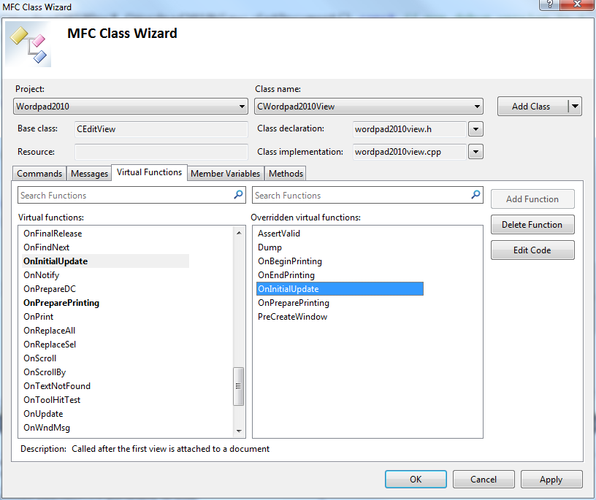
More New Stuff in Visual C++ 2010
IntelliSense that actually works ☺
Including new features such as
#include auto completion
Call hierarchy
Red squiggles
Find all references
Class wizard

Slide 42
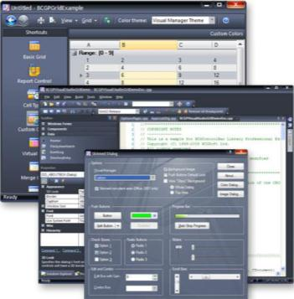
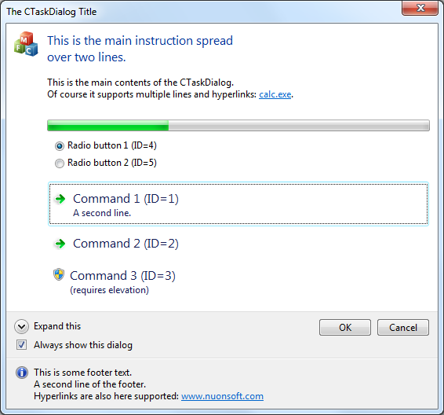
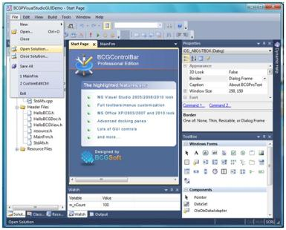
Visual C++ 2010
Profiler including multithreaded profiler (only in Premium; Ultimate)
More modern MFC library (BCG)
CTaskDialog
Ribon bar + designer
Modern UIs

Slide 43
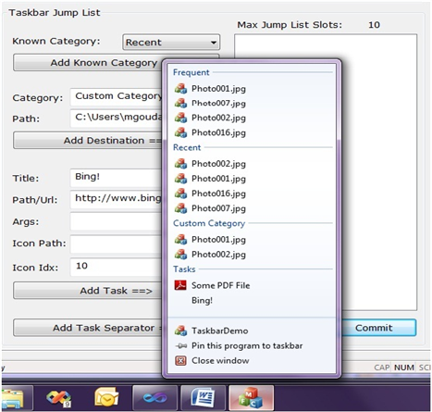
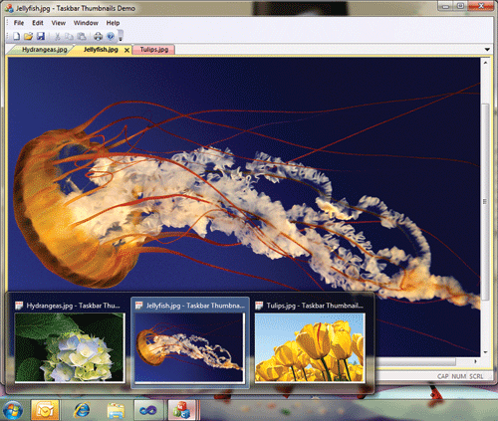
Visual C++ 2010
More modern MFC library
Windows 7 taskbar integration

Slide 44
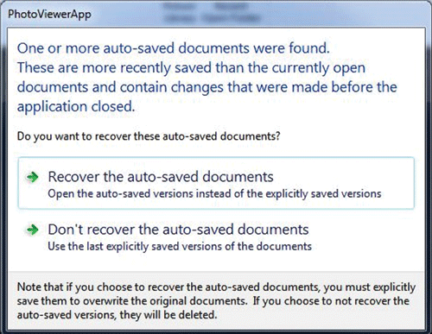
Visual C++ 2010
More modern MFC library
Restart manager
Multitouch aware
High-DPI aware
Support for animation / Direct2D graphics

Slide 45
Questions
?
Any views or opinions expressed in this presentation are solely those of the author and do not necessarily represent those of my company.

